Slide 1


How to do everything with PowerShell
Barcelona
Juan Carlos González
September 26th, 2015
Notes:
Template may not be modified
Twitter hashtag: #spsbe for all sessions

Slide 2













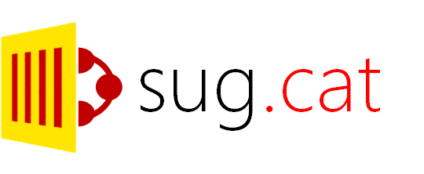

Thanks to our Sponsors
Notes:
So first of all, thanks to the organization and thanks to all the sponsors for making possible this fantastic event

Slide 3
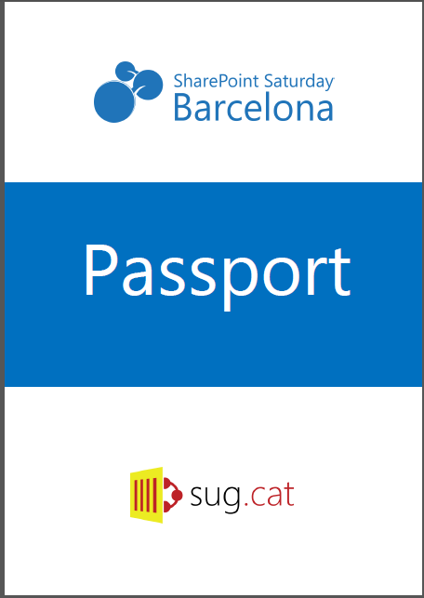



The SPSBCN Passport
Get stamps from all the sponsors
Deposit the passport to enter the prize raffle
Good luck!

Slide 4


SharePint sponsored by
FREE BEER!
Get your ticket at the registration desk
Network and have fun with your colleagues!
Michael Collins Pub
Plaça de Sagrada Família
Starts at 19:30h

Slide 5
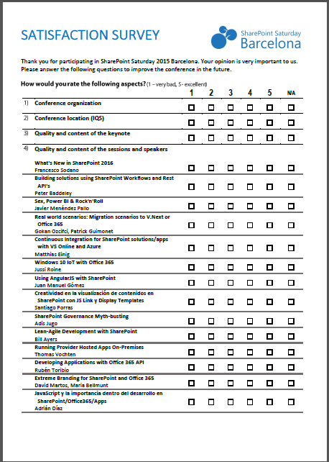
Remember to fill your evaluation forms
They help us improve for SharePoint Saturday 2016!

Slide 6

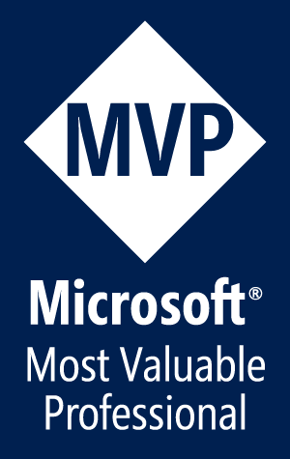
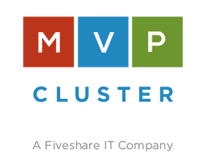


Juan Carlos González
Office 365 MVP
Cloud & Productivity Advisor at MVP CLUSTER
SUGES, Comunidad de O365 & Nuberos.Net coordinator
CompartiMOSS Co-Director (www.compartimoss.com)
Some ways to contact me:
Twitter: jcgm1978
LinkedIn: https://nl.linkedin.com/in/juagon
Contact E-Mails:
jcgonzalezmartin1978@Hotmail.com
juancarlos.gonzalez@fiveshareit.es
Blog: https://jcgonzalezmartin.wordpress.com/
MVP CLUSTER Web Site: www.mvpcluster.com
Notes:
Here you can see some of my community activities and also some of my contact details (contact e-mails, Twitter, LinkedInd)

Slide 7
Agenda
PowerShell Development Environments
Default PowerShell cmdlets
CONCLUSIONS
PowerShell usage scenarios
Using SharePoint APIs in PowerShell

Slide 8
PowerShell for SharePoint possibilities
What can I do with PowerShell for SharePoint?
Everything !!!☺
Configuration Tasks
Platform Administration
Auditing Tasks (SharePoint Farm, SPO Tenant)
…
Backup & Restore Operations
Use Server Side / Client Side APIs
Troubleshooting
PowerShell provides several ways to interact and work with SharePoint (OnPrem & Online)
Notes:
As I like to say on my trainings and conferences: everything!!!

Slide 9
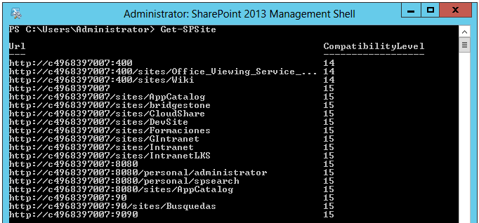
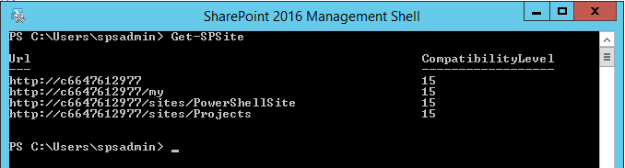
PowerShell Development Environments
SharePoint OnPremises – SharePoint Management Shell:
Available by default on every WFE / Application Server in a SharePoint Farm
It provides access in the box to all the SharePoint cmdlets

Slide 10
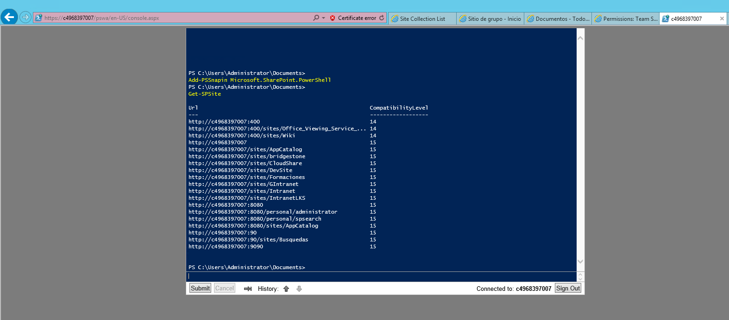
PowerShell Development Environments
SharePoint OnPremises – PowerShell Web Access:

Slide 11
PowerShell Development Environments
SharePoint OnPremises – PowerShell Web Access:
It provides a way to execute PowerShell cmdlets in the Browser
In order to use it you have to:
Enable PowerShell Web Access feature at the WFE(s) level
Install/Enable PowerShell Web Access components using PowerShell
Configure Default IIS Web Site on every SharePoint WFE(s) you want to use PowerShell Web Access
Install-PswaWebApplication –UseTestCertificate Add-PswaAuthorizationRule -UserName [Dominio]\[Usuario] -ComputerName [NombreComputador] -ConfigurationName Microsoft.Powershell

Slide 12
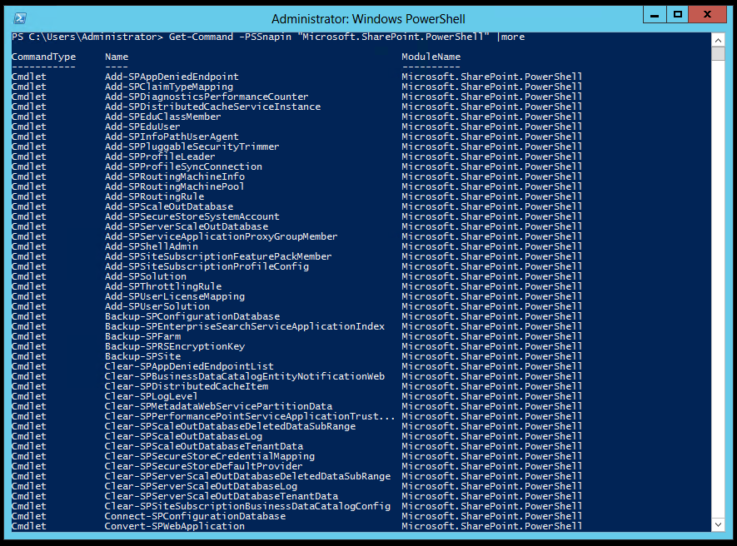
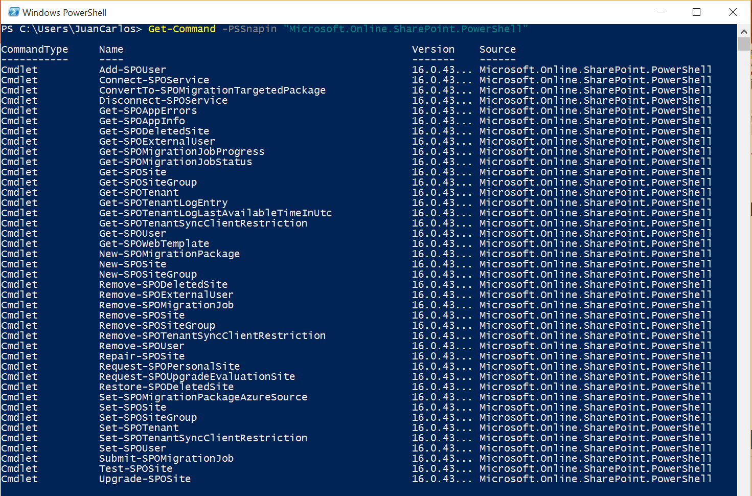
PowerShell Development Environments
SharePoint OnPremises y SPO – Windows PowerShell:
For SP OnPremises, the SharePoint Snap-In has to be loaded at first

Slide 13
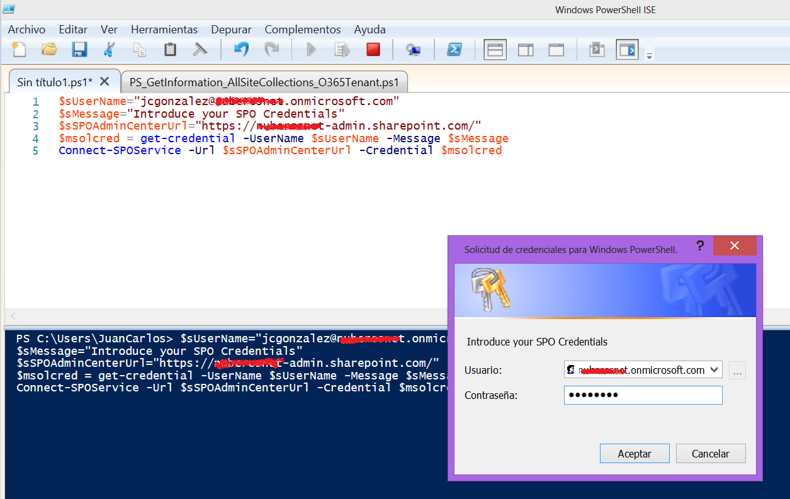
PowerShell Development Environments
SharePoint OnPremises y SPO – ISE:

Slide 14
PowerShell Development Environments
PowerShell ISE:
It’s “almost” a development environment for PowerShell providing features such as Debugging Intellisense Code Coloring …
Each new ISE version release adds new features and improvements
It is a feature provided by default in Windows (Client and Server Editions), although there are some cases you need to enable it (Windows Server 2008 R2)
SharePoint Snap-In must be previously loaded in the ISE in order to be able to use SharePoint OnPremises PowerShell cmdelts
This step is not required for SPO

Slide 15
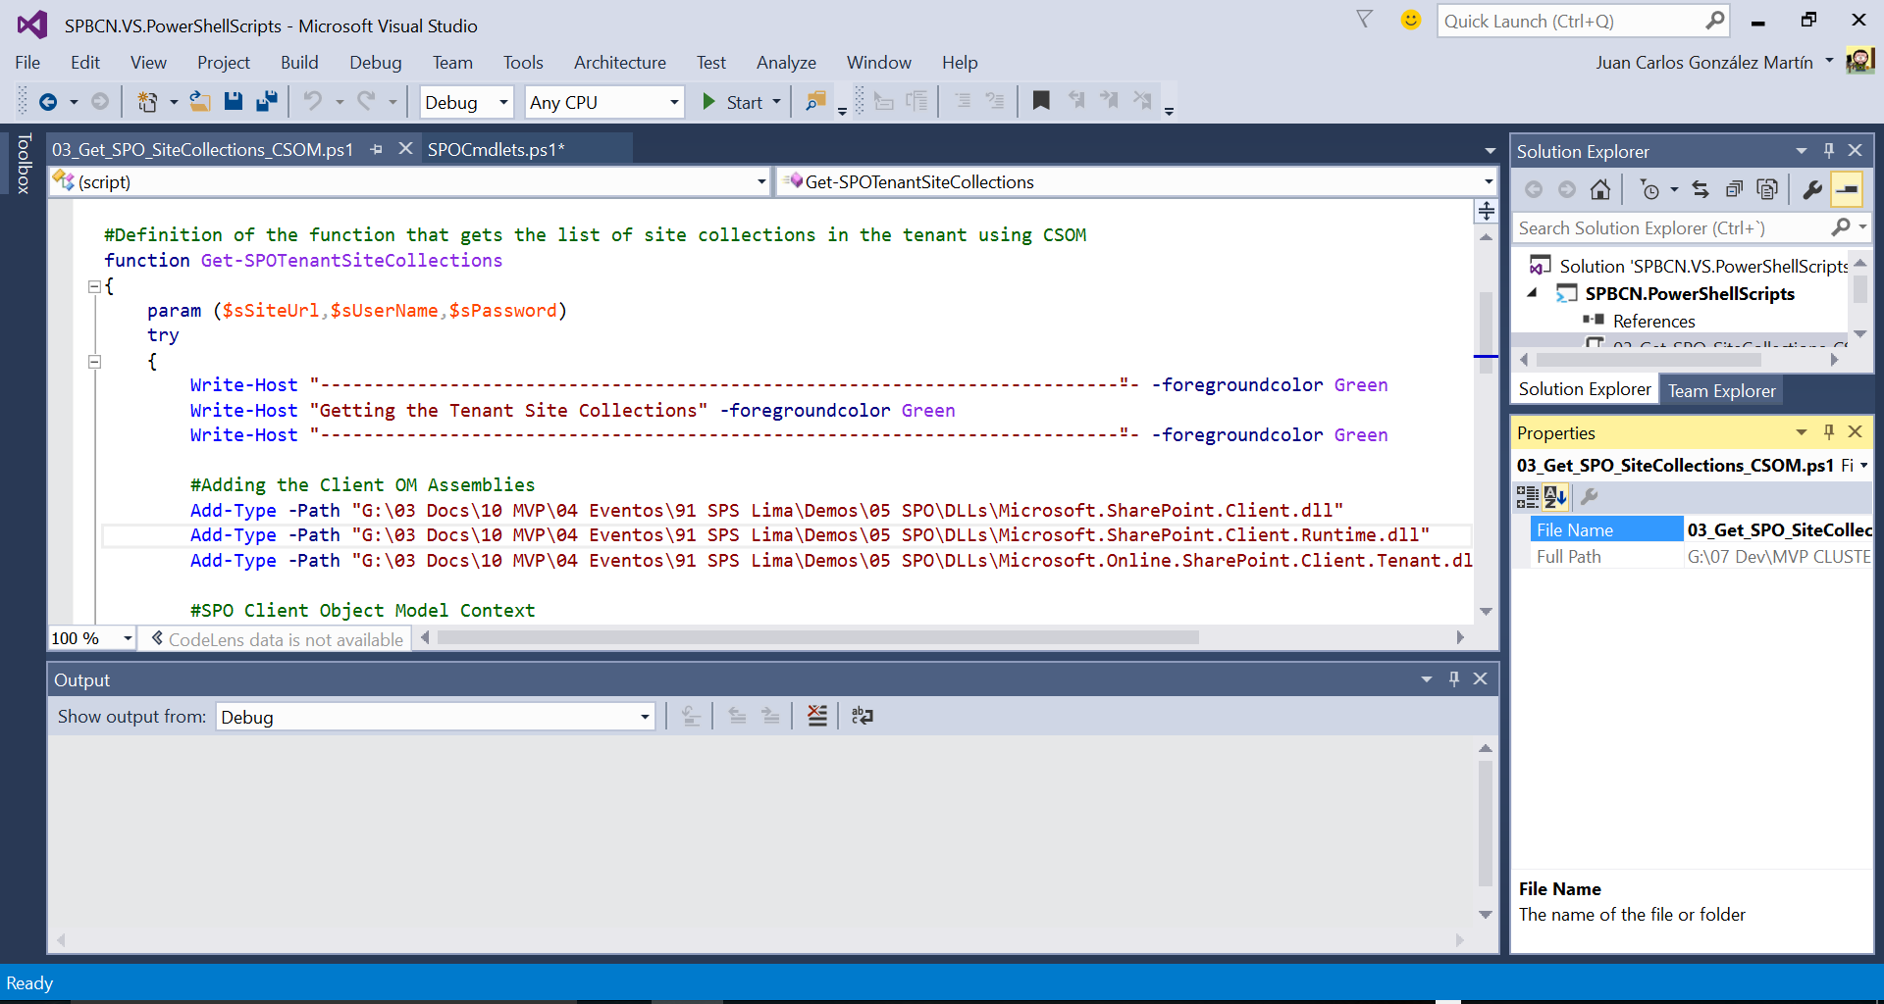
PowerShell Development Environments
SharePoint OnPremises y SPO – Visual Studio:

Slide 16
PowerShell Development Environments
SharePoint OnPremises y SPO – Visual Studio:
PowerShell support in Visual Studio is provided by means of the PowerShell Tools for Visual Studio:
https://visualstudiogallery.msdn.microsoft.com/c9eb3ba8-0c59-4944-9a62-6eee37294597
Some features provided by PowerShell Tools for Visual Studio are:
Create projects for PowerShell scripts and modules
Execute PowerShell Scripts & Commands right from Visual Studio
Edit, run and debug PowerShell scripts locally and remotely using the Visual Studio debugger
Leverage Visual Studio’s locals, watch, call stack, … for your scripts and modules

Slide 17
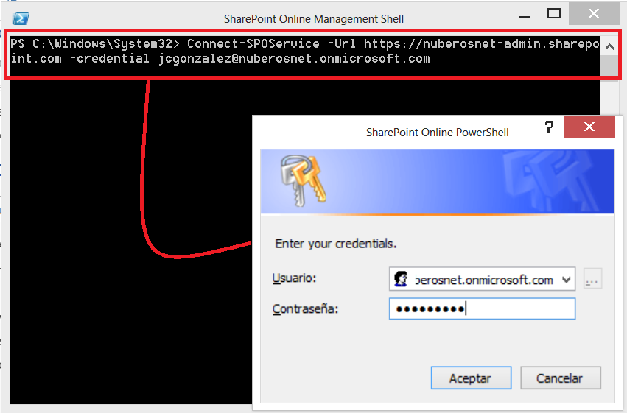
PowerShell Development Environments
SPO – SharePoint Online Management Shell:
It provides a shortcut to SharePoint Online default cmdlets
Updated quite often by Microsoft (last update available: August 2015)

Slide 18



PowerShell Development Environments for SharePoint OnPremises and SPO

Slide 19
Default PowerShell Cmdlets
Components of a PowerShell Cmdlet:
We can create custom cmdlets

Slide 20
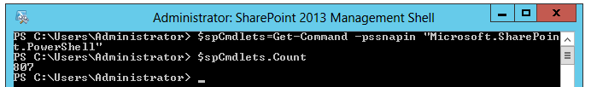
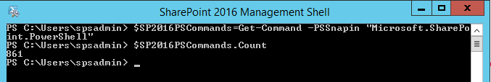
Default PowerShell Cmdlets
SharePoint OnPremises:
More tan 800 cmdlets in SharePoint 2013 SP 1 (861 cmdlets in SP 2016 IT Preview)
Get-Command –PSSnapin "Microsoft.SharePoint.PowerShell"

Slide 21
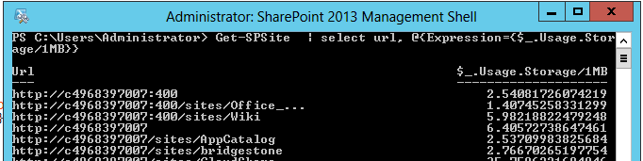
Default PowerShell Cmdlets
Example # 1 - Get-SPSite
It allows to get all the Site Collections in the Farm that match the specified conditions
http://technet.microsoft.com/es-es/library/ff607950(v=office.15).aspx
Get-SPSite | select url, @{Expression={$_.Usage.Storage/1MB}}

Slide 22
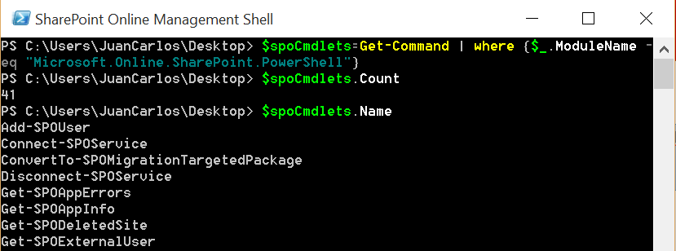
Default PowerShell Cmdlets
SharePoint Online:
More than 40 cmdlets available for SPO (August 2015 update)
$spoCmdlets=Get-Command | where {$_.ModuleName -eq “Microsoft.Online.SharePoint.PowerShell"}
$spoCmdlets.Count
$spoCmdlets.Name

Slide 23
Default PowerShell Cmdlets
Example # 1 - Get-SPOSite
It allows to get all the Site Collections in a SharePoint Online tenant that match the specified conditions
https://technet.microsoft.com/es-es/library/FP161380.aspx
#Ejecución en la Consola de Administración de SharePoint Online
$sUserName="jcgonzalez@nuberosnet.onmicrosoft.com"
$sMessage="Introduce your SPO Credentials"
$sSPOAdminCenterUrl="https://nuberosnet-admin.sharepoint.com/"
$msolcred = Get-Credential -UserName $sUserName -Message $sMessage
Connect-SPOService -Url $sSPOAdminCenterUrl -Credential $msolcred
$spoSiteCollections=Get-SPOSite

Slide 24
Default PowerShell cmdlets for SharePoint OnPremises and SPO

Slide 25
Using SharePoint APIs in PowerShell
SharePoint Server Side API:
SharePoint PowerShell Snap-In provides also access to the full server side API:
You can use SharePoint objects in the same way you do in Visual Studio
Example # 1 – How to create a SharePoint list and a add a column to the list:
$spSite=Get-SPSite -Identity $sSiteUrl
$spWeb=$spSite.OpenWeb()
$spWeb.Lists.Add("Lista Grande","Lista Grande",100)
$spFieldType = [Microsoft.SharePoint.SPFieldType]::Text
$spList = $spWeb.Lists["Lista Grande"]
$spList.Fields.Add(“Datos”,$spFieldType,$false)
$spList.Fields["Datos"].Update()
$spList.Update()

Slide 26
Using SharePoint APIs in PowerShell
SharePoint Server Side API:
Example # 2 – How to do a CAML Query:
$spSite=Get-SPSite -Identity $sSiteCollection
$spwWeb=$spSite.OpenWeb()
$splList = $spwWeb.Lists.TryGetList($sListName)
$spqQuery = New-Object Microsoft.SharePoint.SPQuery
$spqQuery.Query =
" <Where>
<Contains>
<FieldRef Name='FileLeafRef' />
<Value Type='File'>Farm</Value>
</Contains>
</Where>"
$spqQuery.ViewFields = "<FieldRef Name='FileLeafRef' /><FieldRef Name='Title' />"
$spqQuery.ViewFieldsOnly = $true
$splListItems = $splList.GetItems($spqQuery)

Slide 27
Using SharePoint APIs in PowerShell
SharePoint Client Side API:
Client Side API (better known as CSOM) can be used in PowerShell for both SharePoint OnPremises and SPO
First step before using the API is to load the required assemblies:
Once the assemblies are loaded, simply follow CSOM rules
Add-Type -Path "<CSOM_Path>\Microsoft.SharePoint.Client.dll"
Add-Type -Path "<CSOM_Path>\Microsoft.SharePoint.Client.Runtime.dll"

Slide 28
Using SharePoint APIs in PowerShell
SharePoint Client Side API:
Example 1 – Using CSOM for SharePoint OnPremises in PowerShell:
#SharePoint Client Object Model Context
$spCtx = New-Object Microsoft.SharePoint.Client.ClientContext($sSiteColUrl)
$spCredentials = New-Object System.Net.NetworkCredential($sUserName,$sPassword,$sDomain)
$spCtx.Credentials = $spCredentials
#Root Web Site
$spRootWebSite = $spCtx.Web
#Collecction of Sites under the Root Web Site
$spSites = $spRootWebSite.Webs
#Loading operations
$spCtx.Load($spRootWebSite)
$spCtx.Load($spSites)
$spCtx.ExecuteQuery()

Slide 29
Using SharePoint APIs in PowerShell
SharePoint Client Side API:
Example 2 – Using CSOM for SPO in PowerShell:
$spoCtx = New-Object Microsoft.SharePoint.Client.ClientContext($sSiteColUrl)
$spoCredentials = New-Object Microsoft.SharePoint.Client.SharePointOnlineCredentials($sUsername, $sPassword)
$spoCtx.Credentials = $spoCredentials
#Root Web Site
$spoRootWebSite = $spoCtx.Web
#Collecction of Sites under the Root Web Site
$spoSites = $spoRootWebSite.Webs
#Loading operations
$spoCtx.Load($spoRootWebSite)
$spoCtx.Load($spoSites)
$spoCtx.ExecuteQuery()
#We need to iterate through the $spoSites Object in order to get individual sites information
foreach($spoSite in $spoSites){
$spoCtx.Load($spoSite)
$spoCtx.ExecuteQuery()
Write-Host $spoSite.Title " - " $spoSite.Url -ForegroundColor Blue
}
Do you see the difference?

Slide 30
Using SharePoint APIs from PowerShell

Slide 31
PowerShell Usage Scenarios
Installation & Configuration
SharePoint Migrations
Troubleshooting
…
Platform Administration
Auditing Tasks (Farm / Tenant Level)
Solutions Deployment
There are several PowerShell usage scenarios in SharePoint (OnPremises and Online)

Slide 32
PowerShell Usage Scenarios
Installation & Configuration:
PowerShell provides more control over the SharePoint installation & configuration process in regards to:
Installation Accounts Database Names Service Applications Configuration …
It takes some more time than the SharePoint visual installation, but you will get two great benefits:
The configuration for all servers in the farm is the same
It’s a more advisable approach in terms of disaster recovery
There are some good scripts that show how you can automate all the installation and configuration of a SharePoint farm:
AutoSPInstaller: http://autospinstaller.codeplex.com/

Slide 33
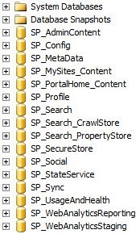
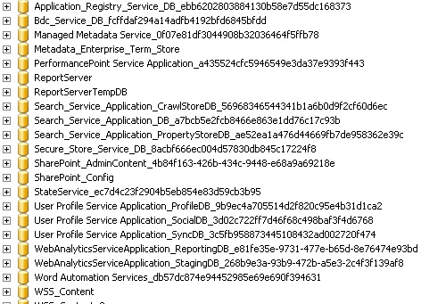
PowerShell Usage Scenarios
Installation & Configuration:
Side effects of a Visual Installation
Using PowerShell

Slide 34
PowerShell Usage Scenarios
Farm / Tenant Administration:
A SharePoint Administrator can do more administration tasks using PowerShell than using the SharePoint Central Administration
For instance, the farm passphrase can only be changed by means of PowerShell
Add-PSSnapin Microsoft.SharePoint.PowerShell
$passphrase = ConvertTo-SecureString –string “<NewPassword>” -asPlainText –Force
Set-SPPassPhrase -PassPhrase $passphrase -Confirm

Slide 35
PowerShell Usage Scenarios
Farm / Tenant Administration:
Example 2 – How to re-start all the timer service instances in a SharePoint farm:
$spFarm=Get-SPFarm
$spfTimerServcicesInstance=$spFarm.TimerService.Instances
foreach ($spfTimerServiceInstance in $spfTimerServcicesInstances)
{
Write-Host "Re-starting the instance " $spfTimerServiceInstance.TypeName
$spfTimerServiceInstance.Stop()
$spfTimerServiceInstance.Start()
Write-Host "SharePoint Timer Service Instance" $spfTimerServiceInstance.TypeName "Re-Started"
}

Slide 36
PowerShell Usage Scenarios
SharePoint Migration & Upgrade scenarios:
For SharePoint 2013 we have several PowerShell cmdlets for doing SharePoint migration and upgrading tasks
Service Applications level:
New-SPBusinessDataCatalogServiceApplication
Restore-SPEnterpriseSearchServiceApplication
Upgrade-SPEnterpriseSearchServiceApplication
Upgrade-SPEnterpriseSearchServiceApplicationSiteSettings
New-SPMetadataServiceApplication
New-SPPerformancePointServiceApplication
New-SPProfileServiceApplication
New-SPProjectServiceApplication
New-New-SPSecureStoreApplication
New-SPSubscriptionSettingsServiceApplication
Content Databases level:
Mount-SPContentDatabase
Test-SPContentDatabase
Upgrade-SPContentDatabase
Site Collections level:
Test-SPSite
Repair-SPSite
Upgrade-SPSite
Request-SPUpgradeEvaluationSiteCollection
Farm level:
Upgrade-SPFarm
Queues Administration:
Get-SPSiteUpgradeSession
Remove-SPSiteUpgradeSession

Slide 37
PowerShell Usage Scenarios
SharePoint Migration & Upgrade scenarios:
Example – How to execute Test-SPContentDatabase in all the Content DBs in a SharePoint 2010 / 2013 Farm:
$sServerInstance=“<Server_Instance>”
$spWebApps = Get-SPWebApplication -IncludeCentralAdministration
foreach($spWebApp in $spWebApps)
{
$ContentDatabases = $spWebApp.ContentDatabases
foreach($ContentDatabase in $ContentDatabases)
{
Test-SPContentDatabase –Name $ContentDatabase.Name -ServerInstance $sServerInstance -WebApplication $spWebApp.Url
}
}

Slide 38
PowerShell Usage Scenarios
Auditing SharePoint Environments:
Through PowerShell you can do auditing tasks such as:
Get detailed information about the logical and information architecture of a farm: Web Applications Site Collections Sites Lists / Document Libraries …
Get information about Content DB sizes, storage being used by Site Collections and Sites
Access to security information in the farm such as authentication methods in use, SharePoint Groups and SharePoint Users defined in farm Site Collections and Sites, Permissions levels, …
Get all the customizations deployed and installed in the farm (.WSPs) + a list of all the features available at different scopes

Slide 39
PowerShell Usage Scenarios
SharePoint Auditing Environments:
Example # 1 - How to get the size of all the Content DBs in a farm:
$spWebApps = Get-SPWebApplication -IncludeCentralAdministration
foreach($spWebApp in $spWebApps)
{
#$spWebApp.Name
$ContentDBs = $spWebApp.ContentDatabases
foreach($ContentDB in $ContentDBs)
{
$ContentDBsize = [Math]::Round(($ContentDB.disksizerequired/1GB),2)
$ContentDBInfo= $spWebApp.DisplayName + "," + $ContentDB.Name + "," + $ContentDBsize + " GB"
$ContentDBInfo
}
}

Slide 40
PowerShell Usage Scenarios
SharePoint Auditing Environments:
Example # 2 - How to extract all the WSPs deployed to a SharePoint farm:
$spFarm=Get-SPFarm
$spSolutions = $spFarm.Solutions
$iSolutionsNumber=0
foreach($spSolution in $spSolutions)
{
$spSolutionFile=$spSolution.SolutionFile
$spSolutionFile.SaveAs($ScriptDir + "\" + $spSolution.DisplayName)
$iSolutionsNumber+=1
}

Slide 41
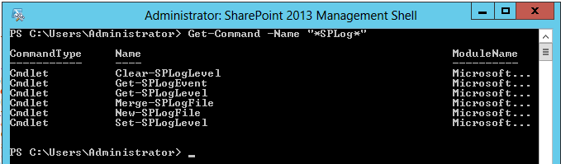
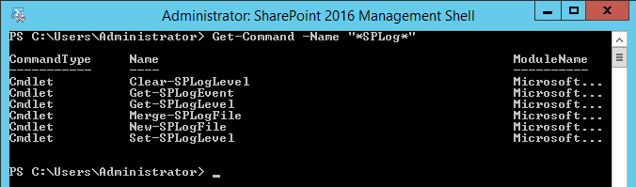
PowerShell Usage Scenarios
Troubleshooting:
Through specific cmdlets to deal with SharePoint LOGS:

Slide 42
PowerShell Usage Scenarios
Troubleshooting:
Example # 1 – Enable / Disable the Developer Dashboard:
$svc=[Microsoft.SharePoint.Administration.SPWebService]::ContentService $ddsetting=$svc.DeveloperDashboardSettings $ddsetting.DisplayLevel=[Microsoft.SharePoint.Administration.SPDeveloperDashboardLevel]::On
$ddsetting.Update()

Slide 43
PowerShell Usage Scenarios
Solutions deployment / Artifacts provisioning:
Install & deploy SharePoint Solutions (.WSP)
Enable /disable SharePoint features
Apply recursively look & feel customizations to all the sites in a Site Collection
Artifacts provisioning to deploy a complete SharePoint solution by creating Sites, Content Types, Site Columns, Lists, Document Libraries, …
Office 365 PnP Provisioning Engine is a good example of how to automate the provisioning of SharePoint artifacts
https://github.com/OfficeDev/PnP-Provisioning-Schema/wiki
https://github.com/jcgonzalezmartin/jcgonzalez

Slide 44
PowerShell Usage Scenarios for SharePoint

Slide 45
Conclusions
PowerShell for SharePoint is a tool not only for administration and configuration stuff but also for Auditing Troubleshooting Solutions Deployment Use of the SharePoint API
We can work with PowerShell for SharePoint using different development environments:
SharePoint Administration Console PowerShell ISE Visual Studio Windows PowerShell PowerShell Web Acces SPO Administration Console
We have a bunch of PowerShell cmdlets for SharePoint OnPremises and SPO
> 800 cmdlets for SharePoint OnPremises
> 40 cmdlets for SPO
…and we can create our custom cmdlets
In addition to the default cmdlets, we can use SharePoint APIs in our PowerShell scripts…so we can do everything with PowerShell ☺

Slide 46
Q & A
Barcelona

Slide 47
Juan Carlos González
Office 365 MVP
Cloud & Productivity Advisor at MVP CLUSTER
SUGES, Comunidad de O365 & Nuberos.Net coordinator
CompartiMOSS Co-Director (www.compartimoss.com)
Some ways to contact me:
Twitter: jcgm1978
LinkedIn: https://nl.linkedin.com/in/juagon
Contact E-Mails:
jcgonzalezmartin1978@Hotmail.com
juancarlos.gonzalez@fiveshareit.es
Blog: https://jcgonzalezmartin.wordpress.com/
MVP CLUSTER Web Site: www.mvpcluster.com

